Slide 1
Chapter 7:
Creational Design Patterns

Slide 2
Objectives
To introduce creational design patterns
  Factory
  Singleton
  Abstract Factory
  Prototype

Slide 3
Factory Design Pattern
Design Purpose
  Create individual objects in situations where the constructor alone is inadequate.
Design Pattern Summary
  Use methods to return required objects.

Slide 4
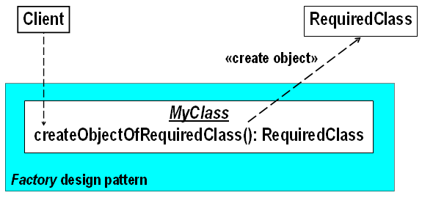
Factory: Class Model
In this model, createObjectOfRequiredClass() is the Factory method

Slide 5
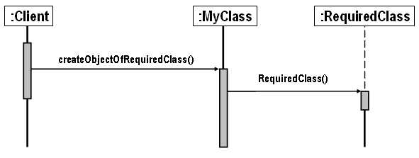
Factory: Sequence Diagram
Factory is an example of the delegation design pattern form
  Factory method delegates the responsibility for creation to a constructor.

Slide 6
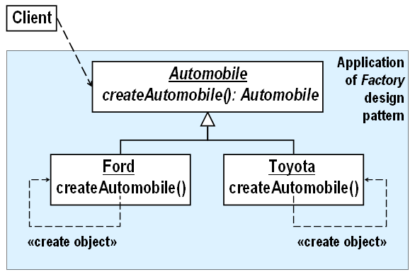
Factory: Example
Use Factory when a base class object is required but the subclass to which it belongs is not known until runtime.

Slide 7
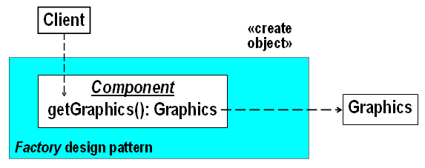
Use of Factory in the Java API
The Java API makes extensive use of Factory.
Example:

Slide 8
Factory: Consequences
It provides hooks for subclasses
  Example: if a make of automobile is added, removed or modified, the design is modified by the addition, removal or modification of Automobile subclass representing that make of automobile.
It makes it easier to check for correctness and to reuse parts.
  Example: the code common to all types of automobiles is separated from the specialized code for each make of automobile.

Slide 9
Singleton Design Pattern
Design Purpose
  Ensure that there is exactly one instance of a class S. Be able to obtain the instance from anywhere in the application.
Design Pattern Summary
  Make the constructor of S private; define a private static attribute for S of type S; define a public accessor for it.

Slide 10
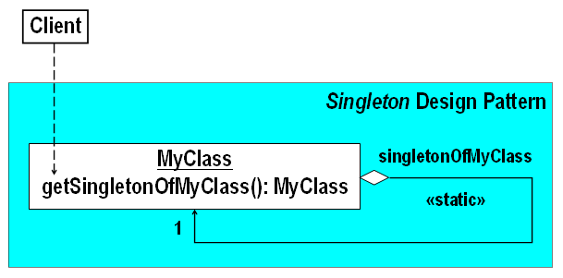
Singleton: Class Model

Slide 11
The Singleton Design Pattern Applied to MyClass: 3 Steps
Define a private static member variable of MyClass of type MyClass
  private static MyClass singletonOfMyClass = new MyClass();
Make the constructor of MyClass private
  private MyClass() { /* …. constructor code …. */ };
Define a public static method to access the member
  public static MyClass getSingletonOfMyClass()
  {
  return singletonOfMyClass;
  }

Slide 12
Use of Singleton in the Java API
“Every Java application has a single instance of class Runtime that allows the application to interface with the environment in which the application is running. The current runtime can be obtained from the getRuntime() method.”

Slide 13
Singleton: Consequences
Correctness
  Singleton enforces the intention that only one XYZ object exists, safeguarding the application from unanticipated XYZ instance creation.
Controlled access to sole instance.

Slide 14
Abstract Factory Design Pattern
Design Purpose
  Provide an interface for creating families of related or dependent objects without specifying their concrete classes.
Design Pattern Summary
  Capture family creation in a class containing a factory method for each class in the family.

Slide 15
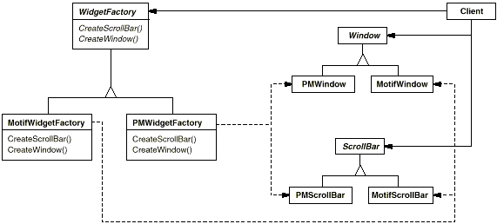
Abstract Factory: Motivation

Slide 16
Abstract Factory: Applicability
Use the Abstract Factory pattern when
  a system should be independent of how its products are created, composed, and represented.
  a system should be configured with one of multiple families of products.
  a family of related product objects is designed to be used together, and you need to enforce this constraint.
  you want to provide a class library of products, and you want to reveal just their interfaces, not their implementations.

Slide 17

Abstract Factory: Class Model

Slide 18
Abstract Factory: Consequences
It isolates concrete classes.
Adding, removing or modifying a style is easy.
Supporting new kinds of products is difficult.

Slide 19
Prototype Design Pattern
Design Purpose
  Create a set of almost identical objects whose type is determined at runtime.
Design Pattern Summary
  Assume that a prototype instance is known; clone it whenever a new instance is needed.

Slide 20
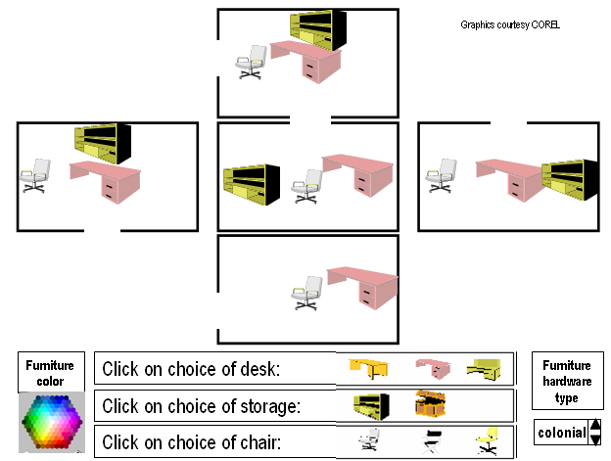
Prototype Design Example:
A Selection

Slide 21
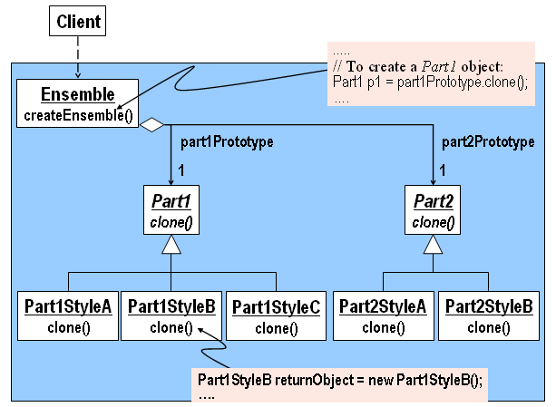
Prototype: Class Model

Slide 22
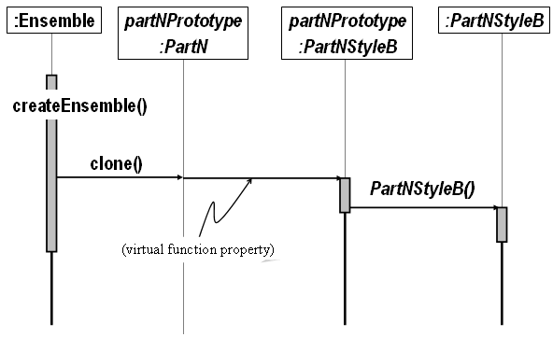
Prototype: Sequence Diagrams

Slide 23
Prototype: Consequences
It is easy to add, remove or modify a part.

Slide 24
Summary of Creational Design Patterns
Use Creational Design Patterns when creating complex objects
  Factory when creating individuals
  Singleton for exactly one, safely
  Abstract Factory when creating families
  Prototype to “mix & match”

